Slide 1
Predicting And Analyzing Urban Water Quality With Machine Learning.
PRESENTED BY:
TEAM NO: CSE-001
18UK1A0559-CHENNABOINA VARUNRAHUL
18UK1A0544-POLU RAVICHANDRA
18UK1A0537-NAGUNURI VIKAS
18UK1A0554-SRIPADA VIJAY

Slide 2
OUTLINE:
INTRODUCTION
OBJECTIVE
DATA
MACHINE LEARNING APPROACHES
VISUALIZATION OF GRAPHS
SOFTWARE REQUIREMENTS
CONCLUSION

Slide 3
INTRODUCTION:
Our bodies use water in all the cells, organs, and tissues, to help regulate body temperature and maintain other bodily functions. Because our bodies lose water through breathing, sweating, and digestion, it's crucial to rehydrate and replace water by drinking fluids and eating foods that contain water.
Top 5 Benefits of Drinking Water
Increases Energy & Relieves Fatigue. Since your brain is mostly water, drinking it helps you think, focus and concentrate better and be more alert. ...
Promotes Weight Loss. ...
Flushes Out Toxins. ...
Improves Skin Complexion. ...
Maintains Regularity.

Slide 4
OBJECTIVE:
The main objective is to explore what kind of data is provided, determine the most important factors to check whether the water is portable or not, and select the most accurate model to suitable for prediction.
Water pollution is a critical issue that can affects humans’ health and the entire ecosystem thus inducing economical and social concerns. In this paper, we focus on water quality prediction system. With the rapid development of economy and accelerated urbanization, water pollution has become more and more serious. Urban water quality is of great importance to our daily lives. Prediction of urban water quality help control water pollution and protect human health.

Slide 5
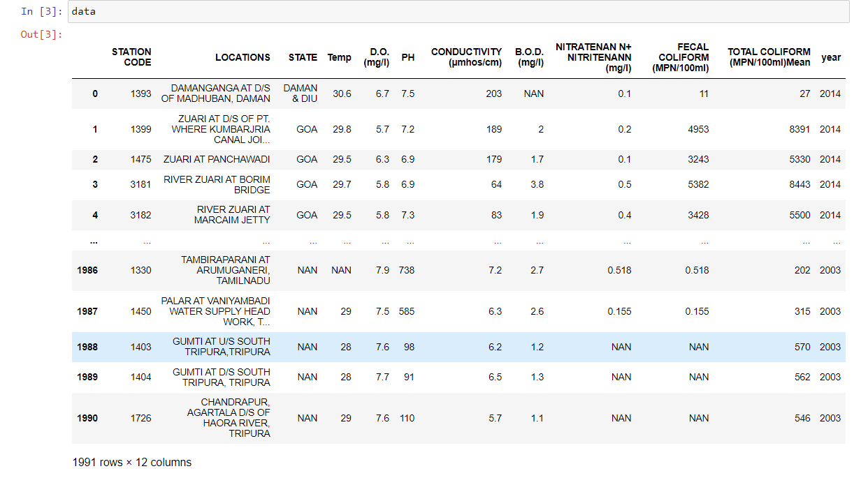
DATA:
Predicting and Analyzing Urban Water Quality dataset consists of:
1992 rows with 12 columns
STATION CODE
LOCATIONS
STATE
Temp
D.O. (mg/l)
PH
CONDUCTIVITY (µmhos/cm)
B.O.D. (mg/l)
NITRATENAN N+ NITRITENANN (mg/l)
FECAL COLIFORM (MPN/100ml)
TOTAL COLIFORM (MPN/100ml)Mean
year
Data source: Internet

Slide 6
DATA VISUALISATION:
Data visualization is where a given dataset is presented in a graphical format. It helps the detection of patterns, trends and correlations that might go undetected in text-based data. Understanding your data and the relationship present within it is just as important as any algorithm used to train your machine learning model. Machine learning models will perform poorly on data that wasn’t visualized and understood properly.
To visualize the dataset we need libraries called Matplotlib and Seaborn. The Matplotlib library is a Python 2D plotting library that allows you to generate plots, scatter plots, histograms, bar charts etc.

Slide 7
MODEL BUILDING:
There are several Machine learning algorithms to be used depending on the data you are going to process such as images, sound, text, and numerical values. The algorithms that you can choose according to the objective that you might have it may be Classification algorithms are Regression algorithms.
Example:
1.Linear Regression
2.Logistic Regression
3. Random Forest Regression / Classification.
4. Decision Tree Regression / Classification.
You will need to train the datasets to run smoothly and see an incremental improvement in the prediction rate.
On our Dataset , we have applied Random Forest to predict the Accuracy.

Slide 8
MACHINE LEARNING ALGORITHMS:
Random Forest :
A random forest is a machine learning technique that’s used to solve regression and classification problems. It utilizes ensemble learning, which is a technique that combines many classifiers to provide solutions to complex problems.
Working of Random Forest Algorithm
Step 1 − First, start with the selection of random samples from a given dataset.
Step 2 − Next, this algorithm will construct a decision tree for every sample. Then it will get the prediction result...
Step 3 − In this step, voting will be performed for every predicted result.
Step 4 − At last, select the most voted prediction result as the final prediction result.

Slide 9
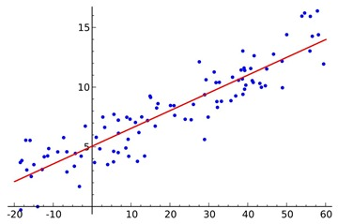
LOGISTIC REGRESSION:
Logistic regression is a supervised learning classification algorithm used to predict the probability of a target variable. The nature of target or dependent variable is dichotomous, which means there would be only two possible classes. ... Mathematically, a logistic regression model predicts P(Y=1) as a function of X.
Logistic Regression is used when the dependent variable (target) is categorical. For example,
To predict whether an email is a spam (1) or (0)
Whether the tumor is malignant (1) or not (0)
Out of all the algorithms Logistic Regression got the highest accuracy .
So, We build a model with Logistic regression.

Slide 10
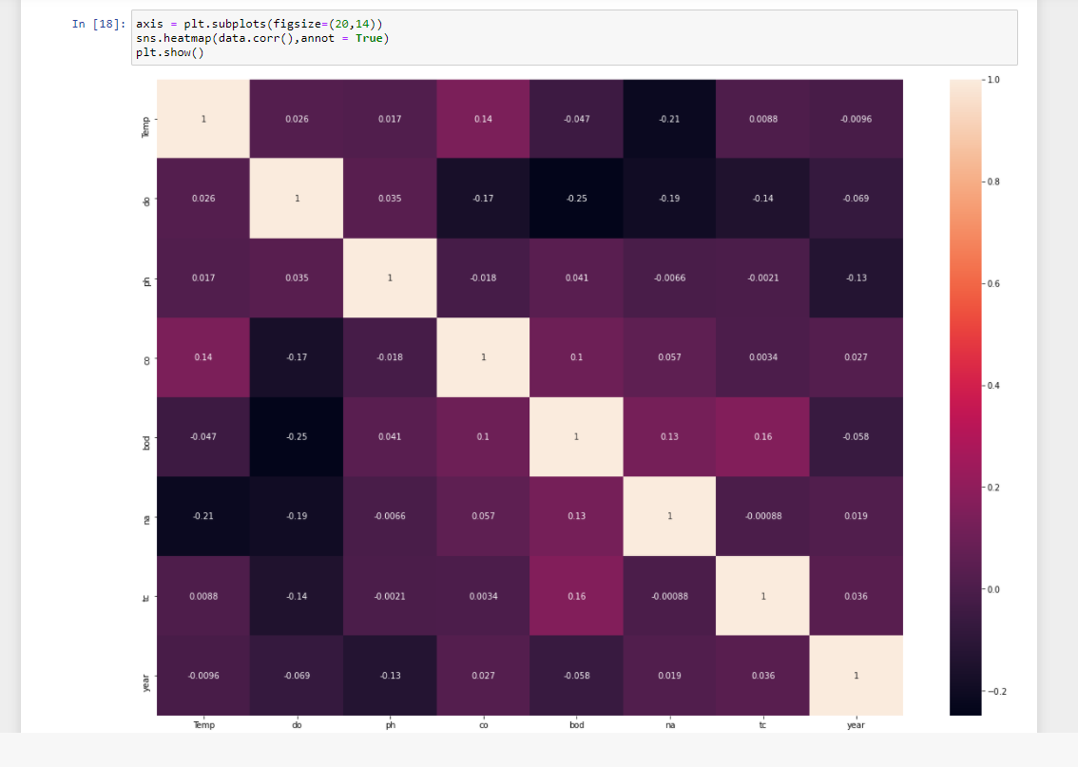
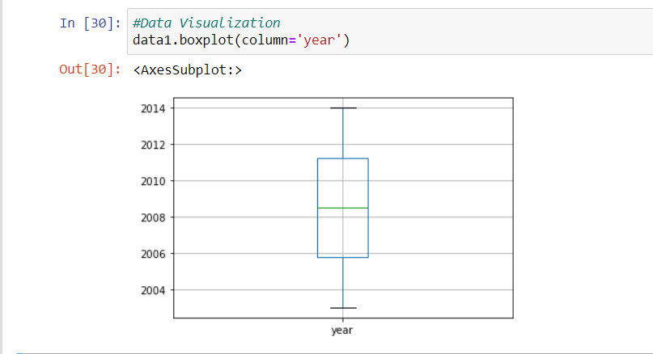
VISUALISATION OF GRAPHS:

Slide 11
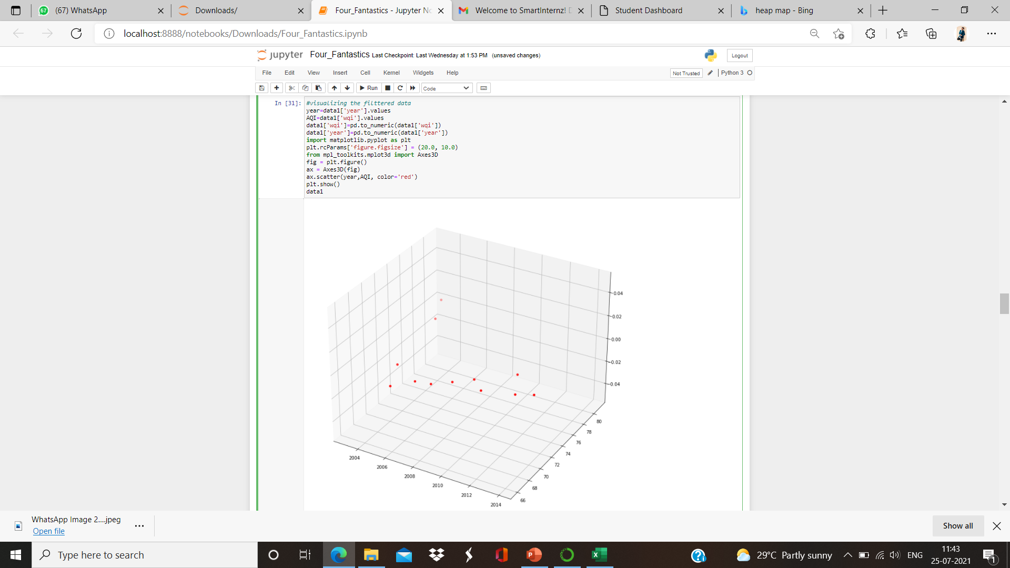
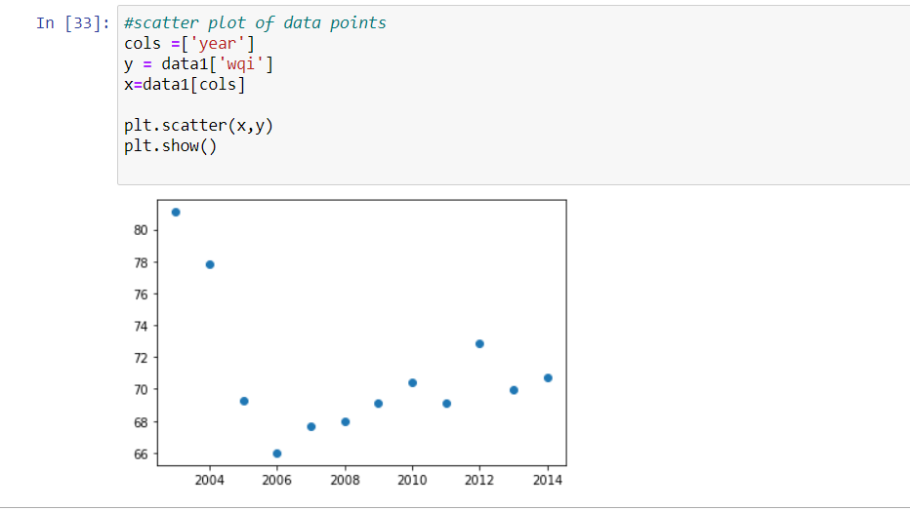

Slide 12
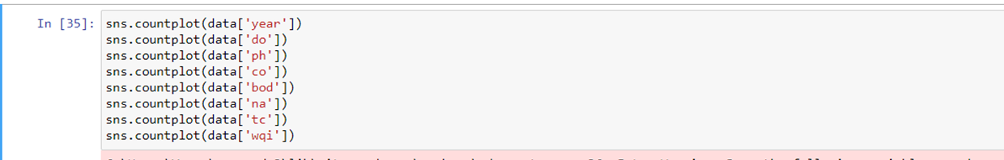
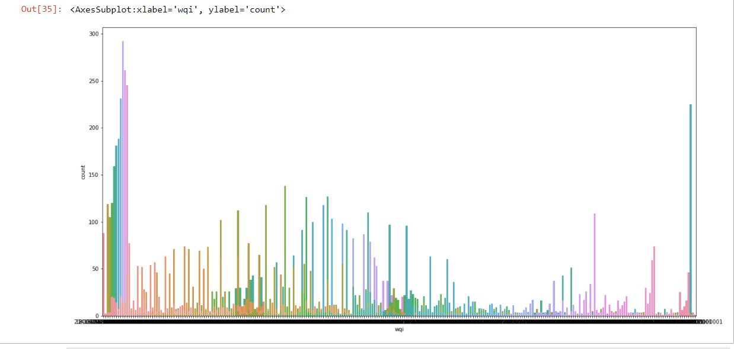
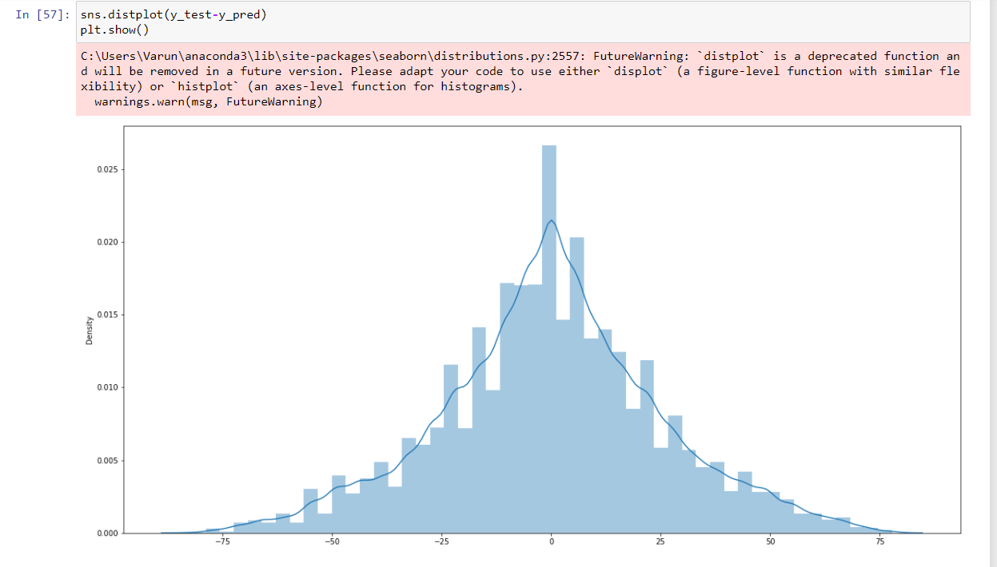

Slide 13
SOFTWARE REQUIREMENTS:
Google colab
Anaconda navigator
Jupyter notebook
Machine learning tools: pandas,
NumPy,
Matplotlib,
Scikitlearn,
Seaborn

Slide 14
CONCLUSION:
In this project we have presented the Predicting And Analyzing Urban Water Quality.
We have done the Prediction using machine learning model.
For the better results we used Random Forest algorithm and proved with 90% accuracy.

